Slide 1
Physics 2A Instructor: Alex Meill

Slide 2
This professor guy
Call me Alex, Professor, Professor Meill, or Professor Alex.
Email: ameill@ucsd.edu
Email Policy: Email anytime, but check the syllabus first.
Office Hours: Mon 10-11:30
Mayer 2681
My research: Quantum Information /Entanglement Theory

Slide 3

Meill

Slide 4
Your fantastic TA
Giulio Meille
Email: gmeille@ucsd.edu
Office Hours: Fri 9:30-11:30am Physics Tutorial Center
Discussion: Thu 5-6pm
CENTR 214
Problem Solving: Wed11am-12:50pm
CENTR 217A
His research: Nonlinear fluid dynamics

Slide 5
Course Outline
Kinematics
Newton’s Laws and Forces
Energy and Momentum
Rotational Motion
Gravity
Harmonic Oscillators
Cool stuff you guys are interest in

Slide 6
Course Objectives
By the end of this course a successful student will be able to…
Analyze arbitrary 2-D motion of objects with constant acceleration.
Interpret the forces present in complex scenarios and solve for their behavior.
Apply energy and momentum techniques to challenging problems.
Extend linear physics to rotational.

Slide 7
Course Structure
Lectures:
Mon, Tue, Wed, Thu 2-3:20pm York 2622
Fri 12-1:50pm York 2722 (Workshop lecture)
Weekly homework: Due day after quiz
Ungraded book problems
Simulations
Videos on TED
Quizes every week (starting next week)
Final Exam

Slide 8
Tips for Success
Be confident
Stay aware of your learning
Did examples / solutions set in?
Ask questions!
Could you teach it?
Readings as your resource
Get ahead on material and practice
Form a study group
Seek a tutor (physics tutorial center or otherwise)

Slide 9
What’s your deal?
Name
Your major and ideal future job (if you know either)
Something (anything) about physics you’re curious about and would like explained.

Slide 10
Today’s Lecture:
Defining the basics
Units
Vectors
Vector algebra
Addition and subtraction
Dot product
Cross product

Slide 11
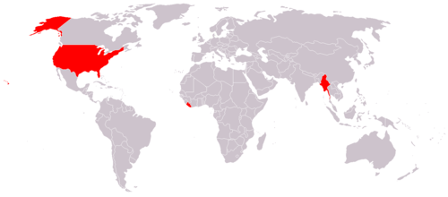
What do these 3 countries have in common?
Myanmar
US
Liberia
Only countries not to adopt SI units

Slide 12
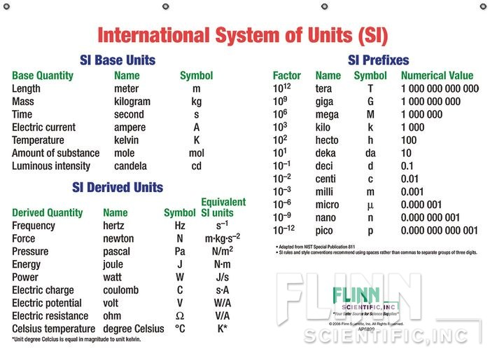
SI Units

Slide 13
Complicated Conversions
Convert to

Slide 14
Vectors
A “vector” is a quantity with both a magnitude and direction.
As opposed to a “scalar”, which just has magnitude.

Slide 15
Which are vectors and which are scalars?
S
Temperature
Acidity (ph)
River current
Weight
“Moving West at 50mph”
S
V
S
V

Slide 16
Vector Addition
Vectors add head to tail
+
=

Slide 17
Which is the right addition? (clicker)
A)
B)
C)
D)

Slide 18
Vector Scaling
Multiplying vectors by a scalar changes their size
=

Slide 19
Vector Subtraction
Try flipping negative vectors first
Then adding

Slide 20
Combining everything (clicker)
Find
C)
A)
D)
B)

Slide 21
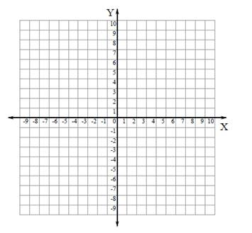
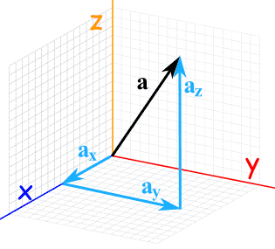
Vector Components
Vectors are often described in terms of their components.

Slide 22
The Coordinate Basis Vectors
Basis vectors have magnitude =1
Point along each axis
z
y
y
x
x

Slide 23
The Coordinate Basis Vectors
They play well with addition/subtraction

Slide 24
Vector algebra with basis vectors
If and
Then what is

Slide 25
Other ways to express vectors
Magnitude and angle
10.78 units pointed
22º below the axis
22º
10.78

Slide 26
Converting between the two
We can always go from angle+magnitude to coordinates and vice versa.
It can be trickier than it seems.
Easy case:
y
x

Slide 27
Converting between the two
We can always go from angle+magnitude to coordinates and vice versa.
It can be trickier than it seems.
Easy case:
y
x

Slide 28
Quick Practice
Find the magnitude and angle of
Find the components of
y
10
40º
x

Slide 29
What makes it tricky
Sometimes the angle is weird
Negative numbers don’t play well with trig functions

Slide 30
Find the components (How I handle it)
Start by redrawing your vector away from the coordinate axes
Add in the components
Treat this new picture as a triangle
All positive side lengths and angles
Solve for the properties of the triangle
30º
8
x
6.92
y
4

Slide 31
Find the components (How I handle it)
Move this picture back to the axes
Add negative signs where appropriate
-
-
6.92
30º
4
8

Slide 32
You try
Find the magnitude and angle (counter-clockwise from the positive x axis) of
122.5º
13.04

Slide 33
Vector Products
Two ways to multiply vectors
Dot product
Gives an answer which is a scalar
Cross product
Gives an answer which is a new vector

Slide 34
The dot product
Definition:
Gives you a measure of how much two vectors overlap

Slide 35
The dot product
Overlap for general vectors:
Line them up tail to tail
Project one down to the other
Scale by the magnitude of the other
Larger vectors and more parallel means larger dot product
Pointed opposite directions makes it negative
Perpendicular vectors have 0 dot product

Slide 36
Quick Practice
Rank these dot products of vectors
A)
C)
D<A<C<B
B)
D)

Slide 37
The cross product
Definition:

Slide 38
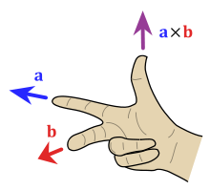
The direction of the cross product
Gives a new vector perpendicular to the two input vectors
Direction given by the right hand rule
What direction is
What direction is

Slide 39
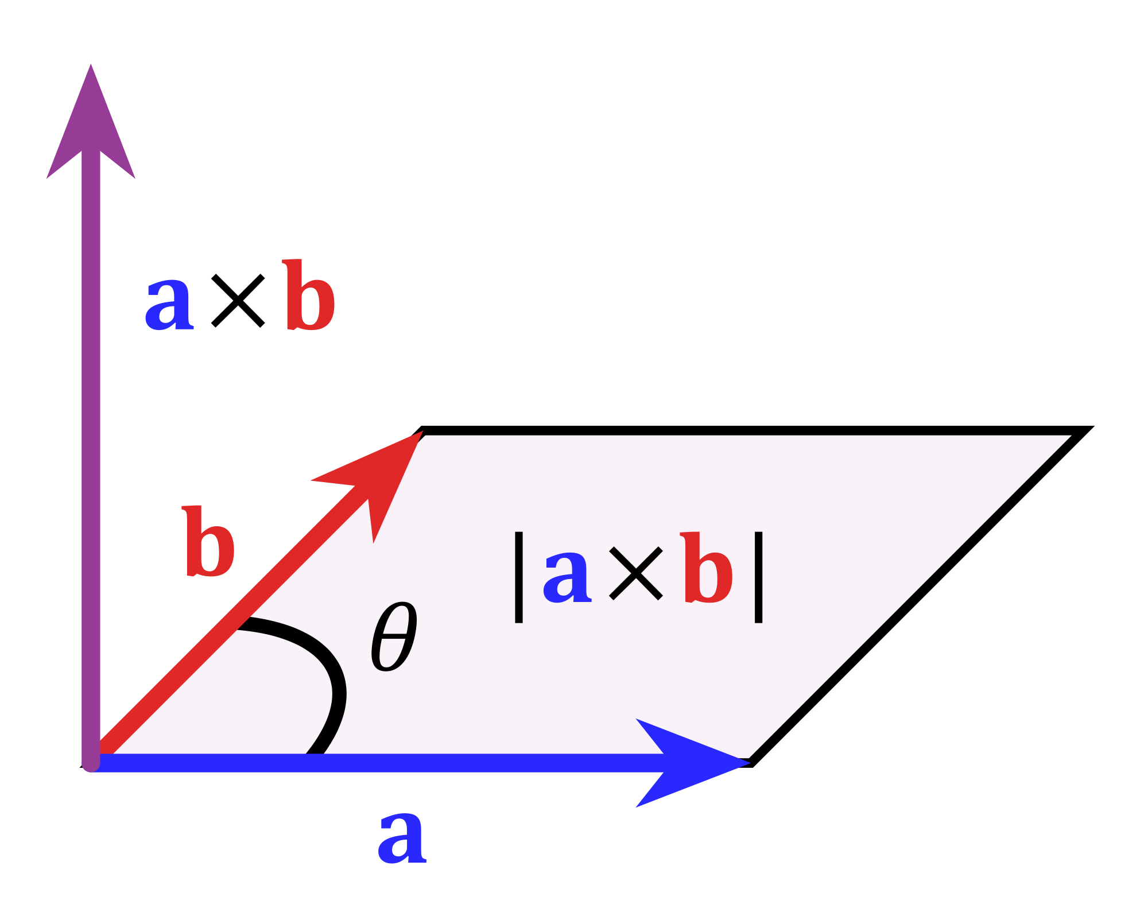
The magnitude of the cross product
Larger vectors closer to perpendicular increases the magnitude of the cross product vectors
Vectors close to parallel have smaller cross products

Slide 41
Next Time:
Kinematics: The study of motion
More detail on position and velocity
New beast: acceleration
Properties
Calculus definitions
The equations of kinematics
Try simulation 1!!!
Do some chapter 1 questions
Read ahead on chapter 2 this time

